Slide 1
Airline yield management
Simulation & Optimization – Group 6
06/01/2021
Andrea Martin |Dharun Vadugappatty Srinivasan | Joseph Tharayil | Jonas Warmuth

Slide 2
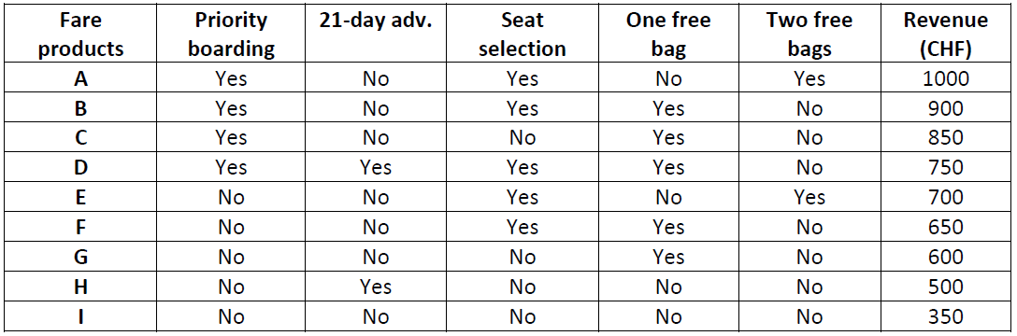



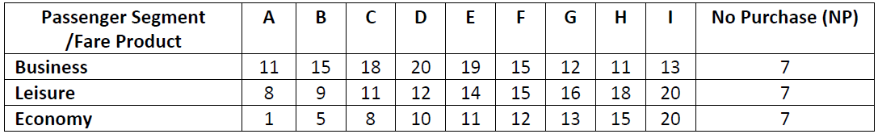
Introduction
Fare buckets
180 seats
Geneva
Washington DC
Passenger types with preferential weights
179
0
Booking time, t (days)
9 fare buckets (A to I) producing different revenues
3 different type of passengers with different arrival rates
Each passenger type has certain preferential weight to select the fare buckets

Slide 3
Introduction
Airline controls inventory by:
(1) booking intervals in which products are available
(2) booking limit for each seat

Slide 4
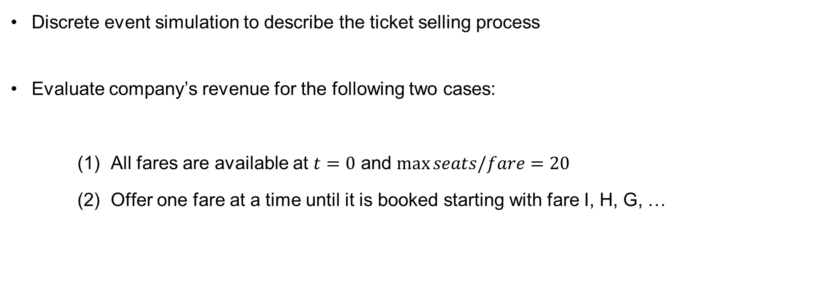
Problem statement
Simulation
Discrete event simulation to describe the ticket selling process
Evaluate company’s revenue for the following two cases:
All fares are available at $t=0$ and $\max_{}{seats/fare=20}$
Offer one fare at a time until it is booked starting with fare I, H, G, …

Slide 5
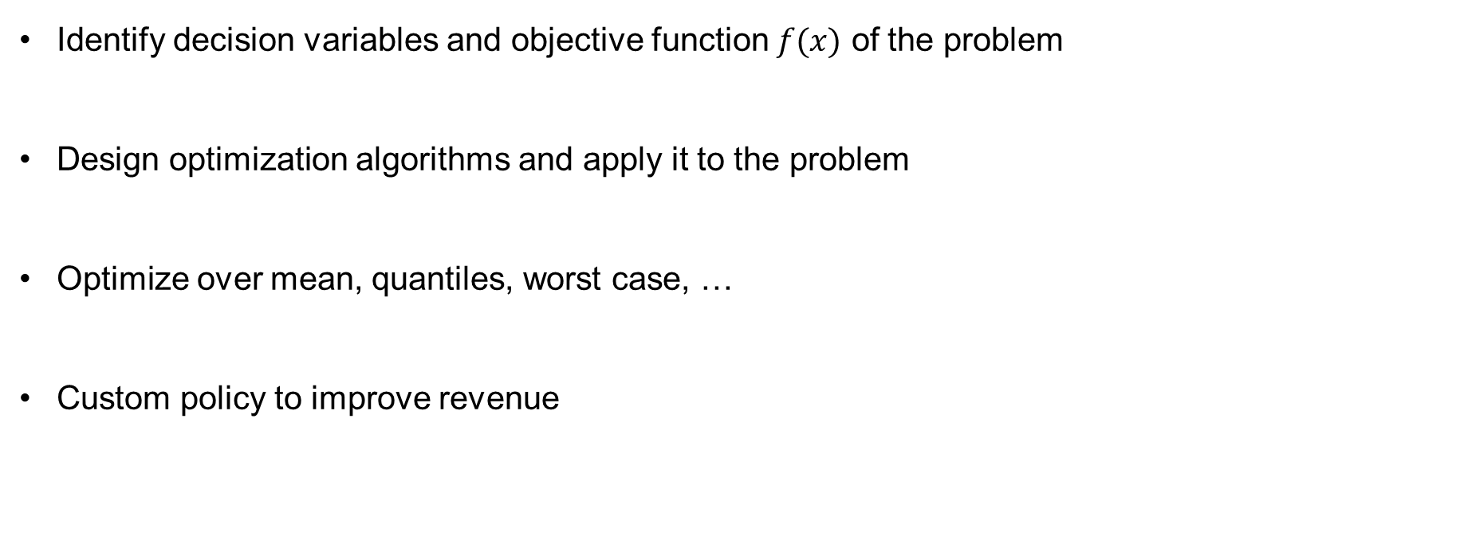
Problem statement
Optimization
Identify decision variables and objective function $f(x)$ of the problem
Design optimization algorithms and apply it to the problem
Optimize over mean, quantiles, worst case, …
Custom policy to improve revenue

Slide 6
Simulation

Slide 7
Simulation workflow
Choices
Simulator
Passengers
Ideal choices
Arrivals
Offered fares
Revenue
Scenario
Duration
Seats sold
Fare selection
Late passengers
Policy
Satisfaction

Slide 8
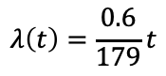
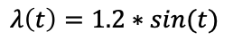
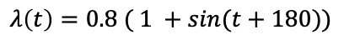
Passenger arrivals as Poisson process
Time-varying arrival rates
Business
$$λ\left(t\right)=1.2∗sin⁡(t)$$
Leisure
$$λ\left(t\right)=\frac{0.6}{179}t$$
Economy
$$λ\left(t\right)=0.8 ( 1 +sin(t+180))$$
Interarrival times are distributed exponentially.
Split the planning horizon into sub-intervals to increase sampling efficiency!

Slide 9
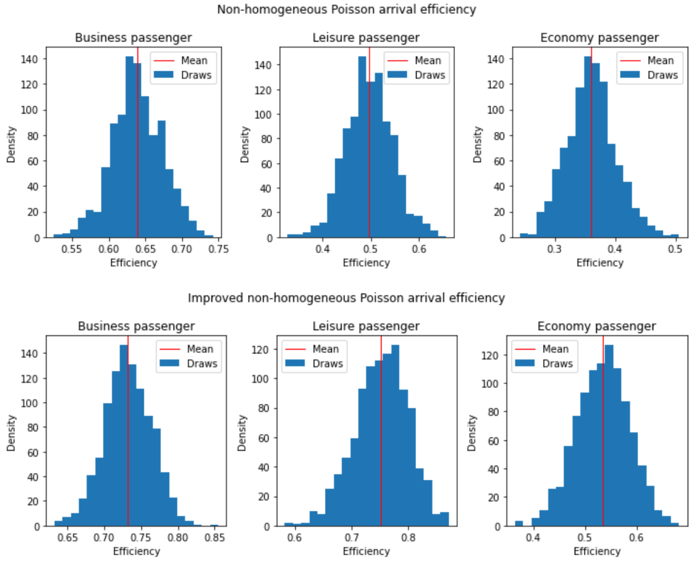
Sampling efficiency over 1000 iterations
Average passenger efficiency:
Business = 0.6392
Leisure = 0.49749
Economy = 0.36081
Average passenger efficiency with piecewise constant threshold:
Business = 0.7321
Leisure = 0.75255
Economy = 0.53462

Slide 10
Discrete event simulator
Generate passenger arrivals according to a non-homogeneous Poisson process.
For each passenger:
Sample the ideal choice of the passenger
Manage the availabilities of the fares according to the arrival time of the passenger
If there are no fares offered and the plane is fully booked, then the customer has arrived late
Sample the choice of the passenger and decrement the availability of the chosen fare, if necessary
If only one fare is offered at a time and its availabilities finished we move to the following product
Remove the processed event from the list
Compute revenues, seats sold, and satisfaction based on the list of choices and ideal choices.

Slide 11
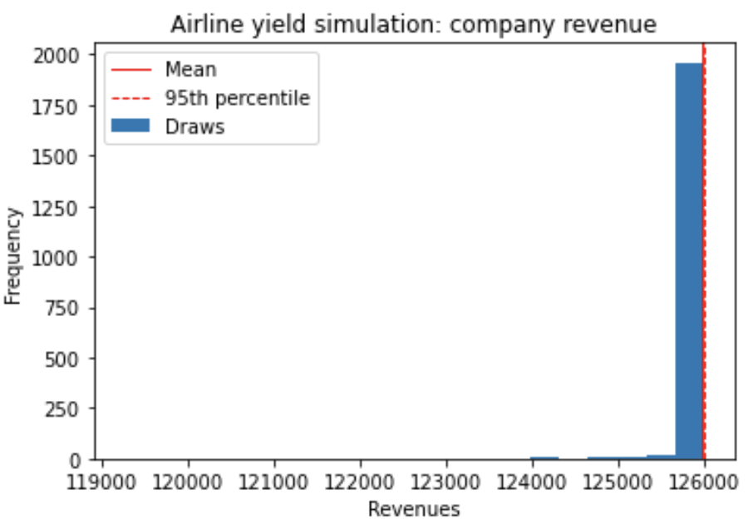
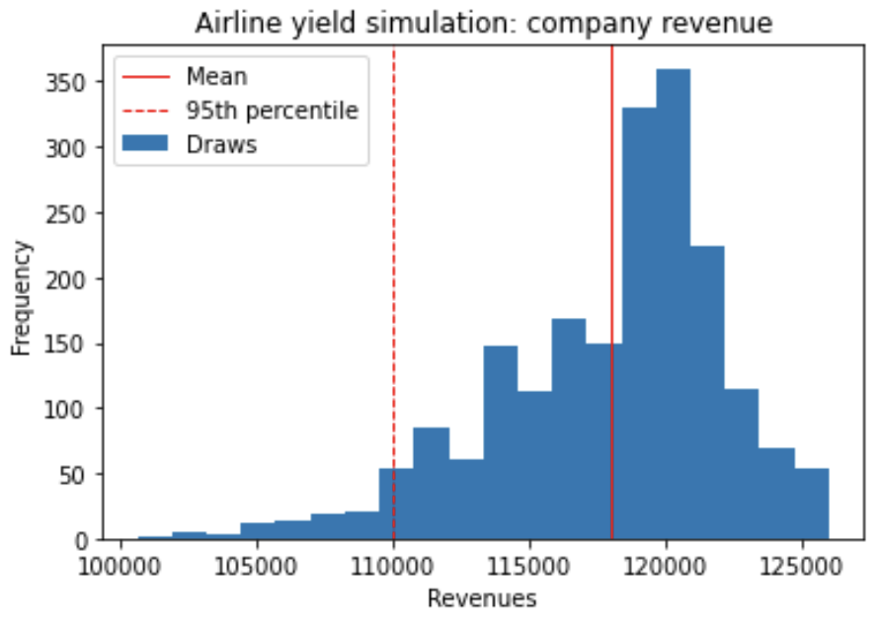
Statistical analysis: revenues
Mean: 125976.6
Bootstrapped MSE: 30.444
Theoretical MSE: 30.146
95% percentile: 126000.0
Bootstrapped MSE: 0.0
Mean: 117992.7
Bootstrapped MSE: 8832.866
Theoretical MSE: 8735.624
95% percentile: 110000.0
Bootstrapped MSE: 39533.199

Slide 12
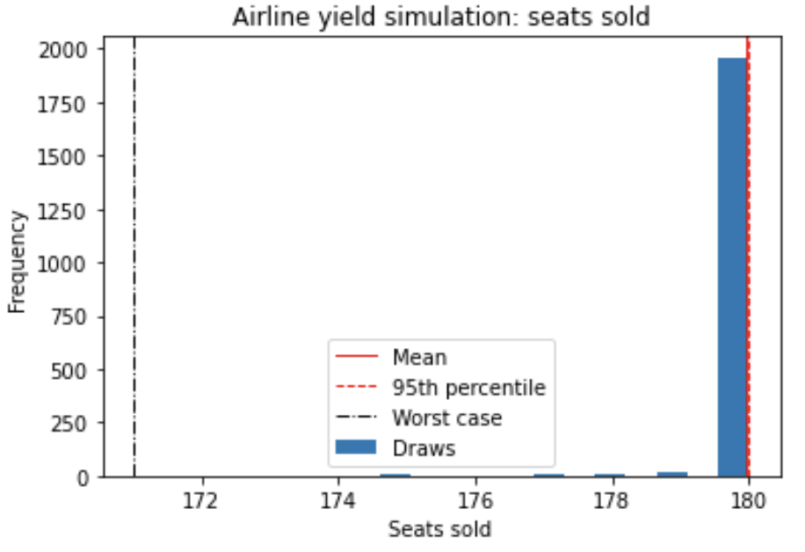
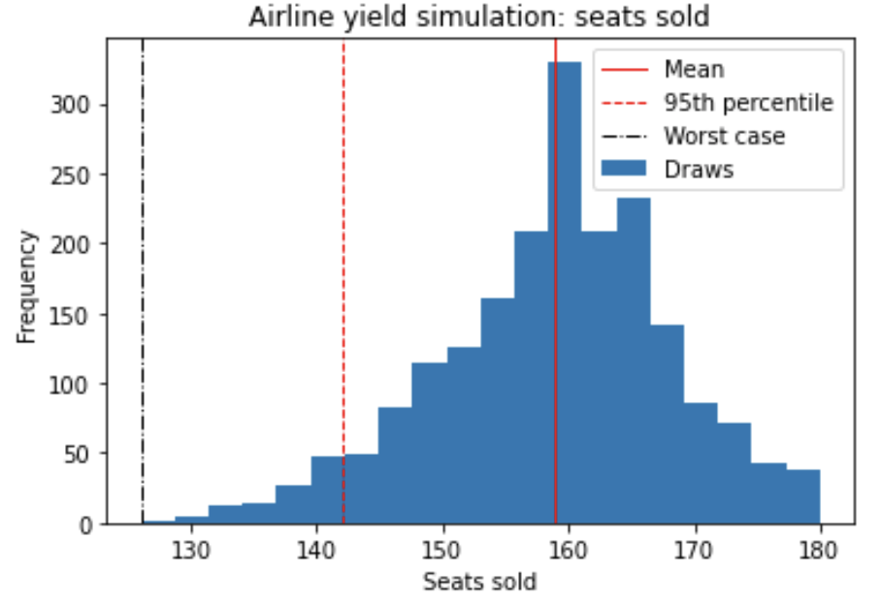
Statistical analysis: seats sold
Mean: 179.9485
Bootstrapped MSE: 0.000113
Theoretical MSE: 0.0001089
95% percentile: 180.0
Bootstrapped MSE: 0.0
Worst case: 171 Bootstrapped MSE: 1.128
Mean: 158.9365
Bootstrapped MSE: 0.04264
Theoretical MSE: 0.043652
95% percentile: 142.0
Bootstrapped MSE: 0.3565
Worst case: 126 Bootstrapped MSE: 2.112

Slide 13
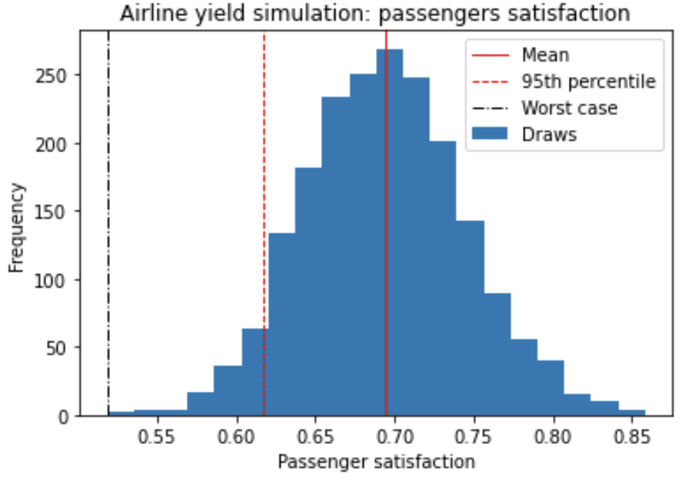
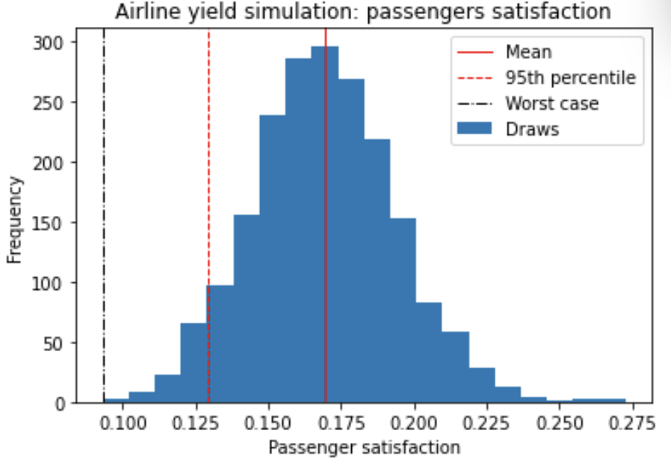
Statistical analysis: satisfaction
Mean: 0.6937
Bootstrapped MSE: 1.414e-06
Theoretical MSE: 1.2627e-06
95% percentile: 0.61659
Bootstrapped MSE: 9.246e-06
Worst case: 0.518 Bootstrapped MSE: 0.000126
Mean: 0.1692
Bootstrapped MSE: 2.662e-07
Theoretical MSE: 2.9831e-07
95% percentile: 0.12902
Bootstrapped MSE: 1.448e-06
Worst case: 0.0930 Bootstrapped MSE: 1.74004e-05

Slide 14
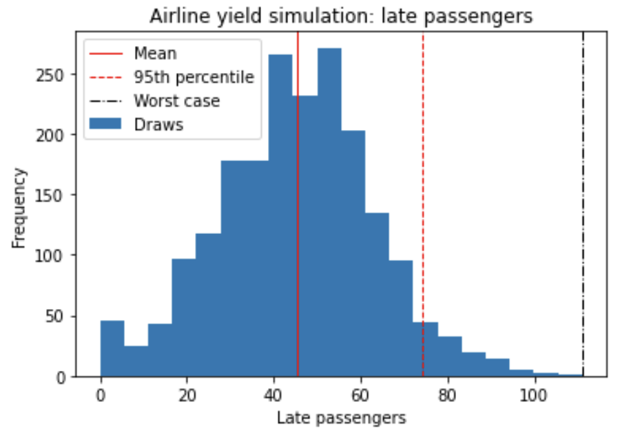
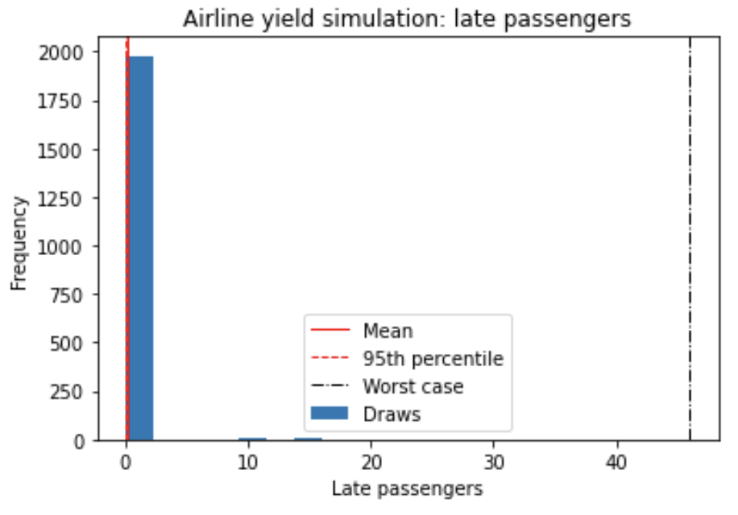
Statistical analysis: late passengers
Mean: 45.212
Bootstrapped MSE: 0.1599
Theoretical MSE: 0.16315
95% percentile: 74.049
Bootstrapped MSE: 1.21243
Worst case: 111 Bootstrapped MSE: 27.198
Mean: 0.182
Bootstrapped MSE: 0.001946
Theoretical MSE: 0.0019594
95% percentile: 0.0
Bootstrapped MSE: 0.0
Worst case: 46 Bootstrapped MSE: 129.028

Slide 15
Numerical comparison
Quantity | Metrics | Scenario 1 All fare available from the beginning | Bootstrapped MSE | Scenario 2 One fare available at a time | Bootstrapped MSE
Company revenue | Mean | 125976.6 | 30.146 | 117992.7 | 8832.866
 | 95% percentile | 126000.0 | 0.00 | 110000.0 | 39533.199
Seats sold | Mean | 179.9485 | 0.000113 | 158.9365 | 0.04264
 | 95% percentile | 180 | 0.00 | 142 | 0.3565
 | Worst case | 171 | 1.128 | 126 | 2.112
Late passengers | Mean | 45.212 | 0.1599 | 0.182 | 0.001964
 | 95% percentile | 74.049 | 1.21243 | 0 | 0
 | Worst case | 111 | 27.198 | 46 | 129.028
Passenger satisfaction | Mean | 0.6937 | 1.414e-06 | 0.1692 | 2.662e-07
 | 95% percentile | 0.61659 | 9.246e-06 | 0.12902 | 1.448e-06
 | Worst case | 0.518 | 0.000126 | 0.0940 | 1.74004e-05

Slide 16
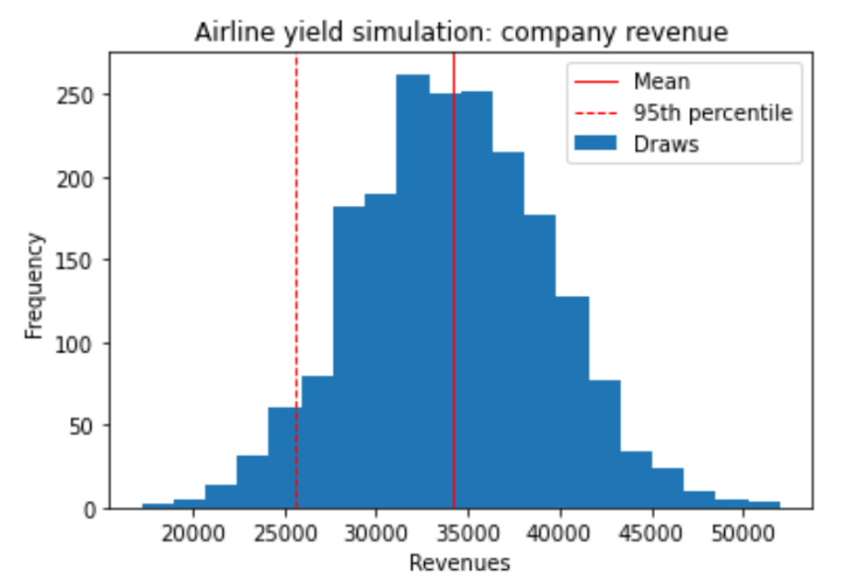
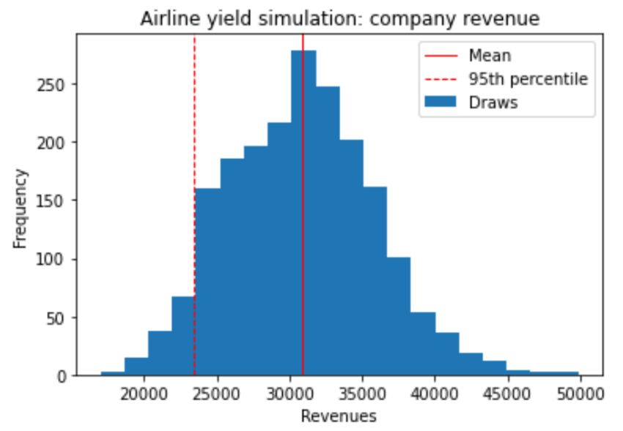
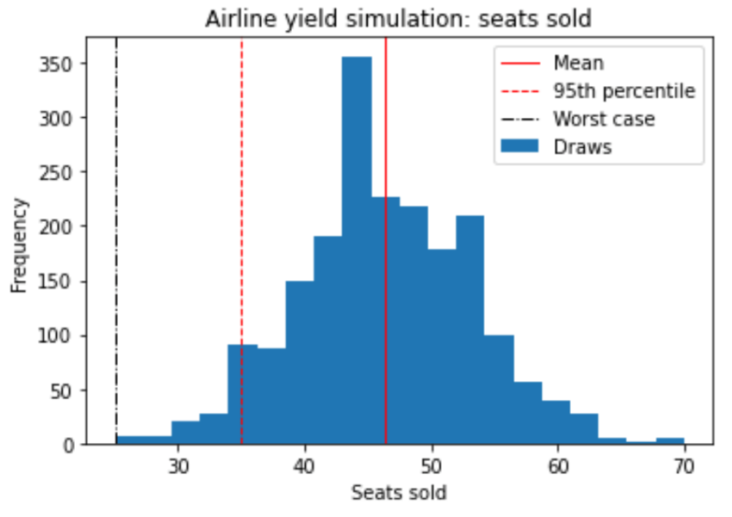
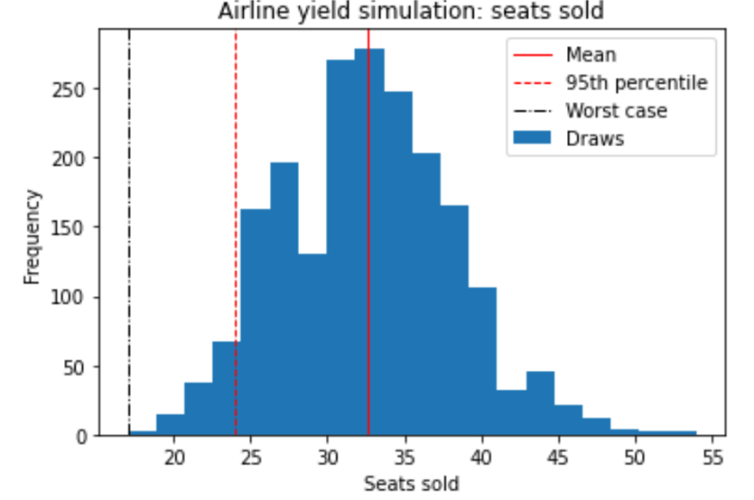
What if we reduce the planning horizon?
Even with T = 50, offering one fare at a time proves less effective!
If the airplane has unsold seats at the end of the planning horizon, we want to reduce as much as possible the possibility of the passenger choosing not to purchase anything.

Slide 17
Observations
If all fares are offered from the beginning, the maximum airplane capacity is reached.
If all fares are offered from the beginning, the revenues are almost constant.
If only one fare at a time is offered, passengers will not purchase any ticket with probability at least 0.25!
If only one fare at a time is offered, the airline company should consider longer planning horizon (a low-profit fare is better than an unsold seat!).
As expected, the wider the offer the more satisfied the passengers.

Slide 18
Optimization

Slide 19
Optimization
Objective functions
Mean revenue
Passenger satisfaction
Percentage of customers whose first choices are available
Optimization variables
Tickets available per fare bucket
Cutoff times for each fare bucket
Algorithms used
Full enumeration
Local search
Variable neighborhood search
Simulated annealing

Slide 20
Neighborhood structure
Local Search, SA:
At each iteration, change a single fare bucket by 1
For number of tickets, decrease another by 1 to keep number of tickets constant
VNS:
Change values in N fare buckets by 1
Full enumeration
Randomize values, within constraints

Slide 21
Simulated annealing
SA in multi-objective optimization is non-trivial
We use a weak acceptance rule (see Amine 2019)
Accept solution if it dominates
Probabilistically accept solution otherwise
Probability based on weighted sum of two objective functions
Weights set to assign approximately equal value to each

Slide 22
Comparison of optimization methods
We try optimization on availabilities and cutoffs separately, as well as simultaneously
Clear tradeoff between revenue and customer satisfaction
Optimization on cutoffs does not produce large Pareto front
VNS seems to produce best results

Slide 23
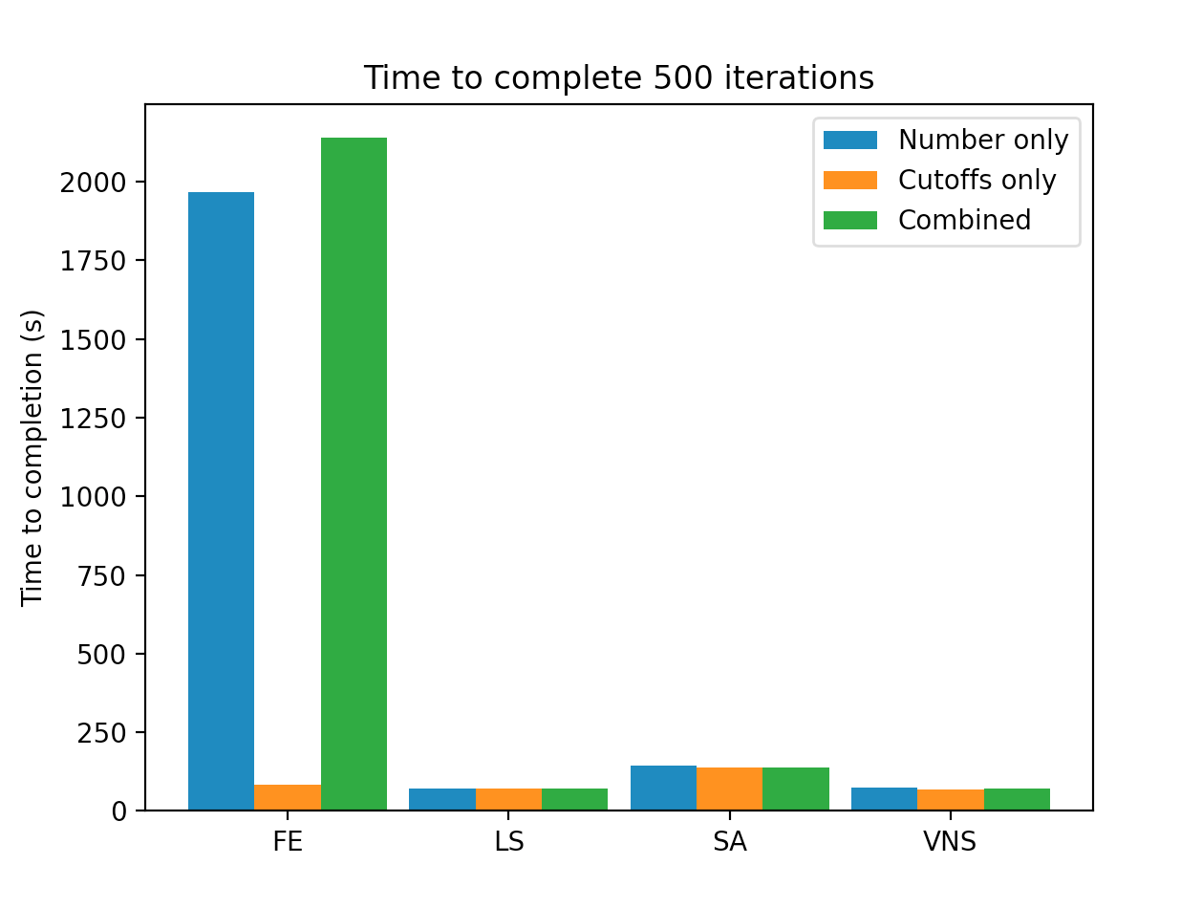
Efficiency of different algorithms
Full enumeration takes infeasibly long
Due to need to find ‘changeable’ values on each iteration
Simulated annealing slightly longer than VNS and LS

Slide 24
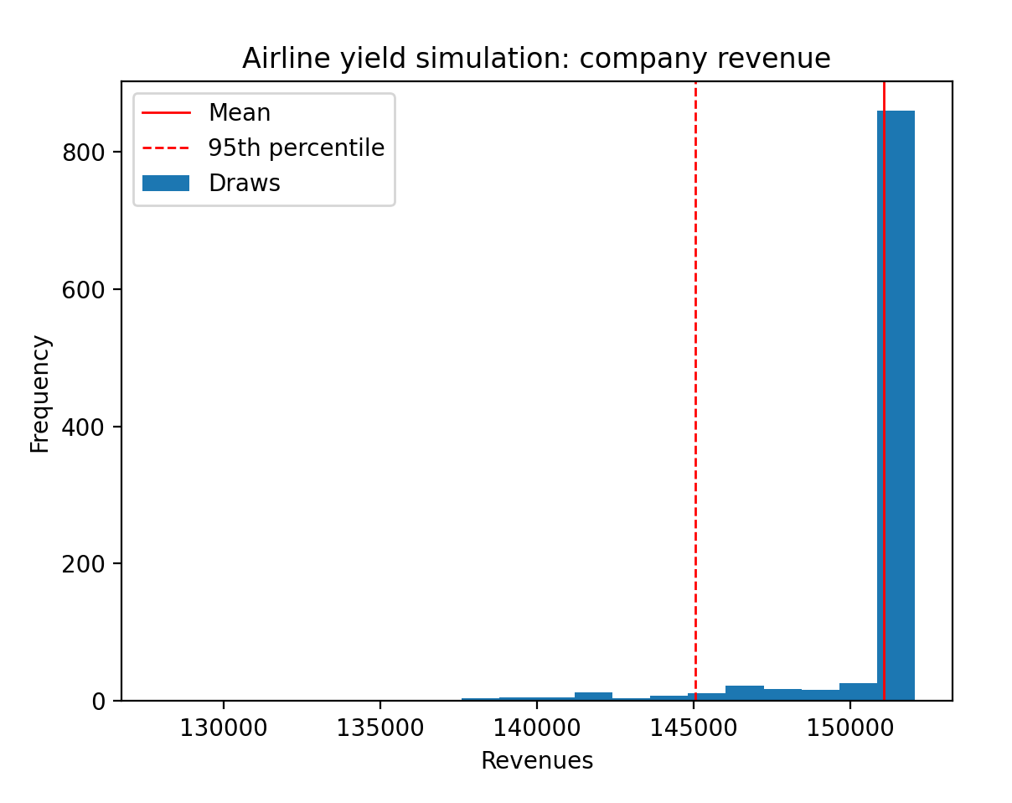
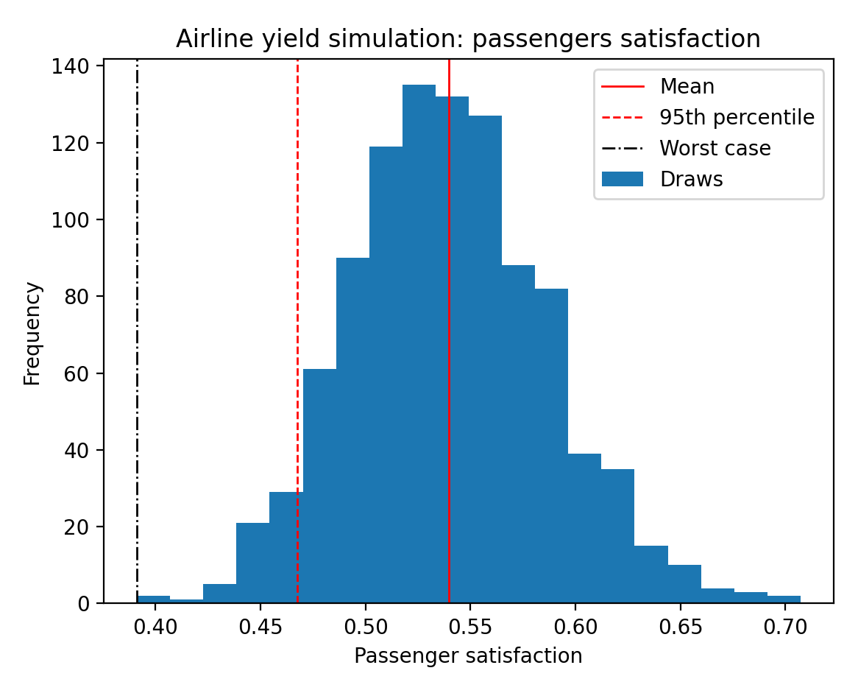
Statistics on highest-revenue solution
Mean: 151075.2
Bootstrapped MSE: 9281.626740000216
Theoretical MSE: 8733.92496
95% percentile: 145050.0
Bootstrapped MSE: 0.0
Mean: 0.5395192270309297
Bootstrapped MSE: 2.1476087391148124e-06
Theoretical MSE: 2.18979214591017e-06
95% percentile: 0.46752033013715255
Bootstrapped MSE: 8.82530785733501e-06

Slide 25
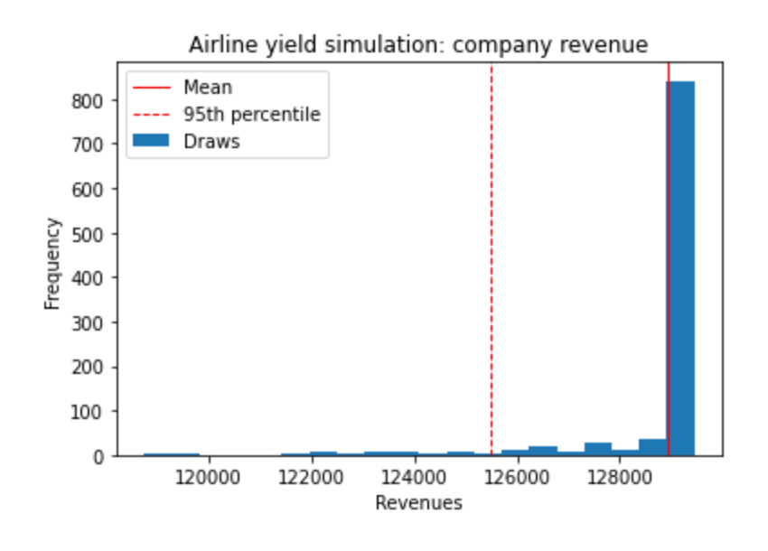
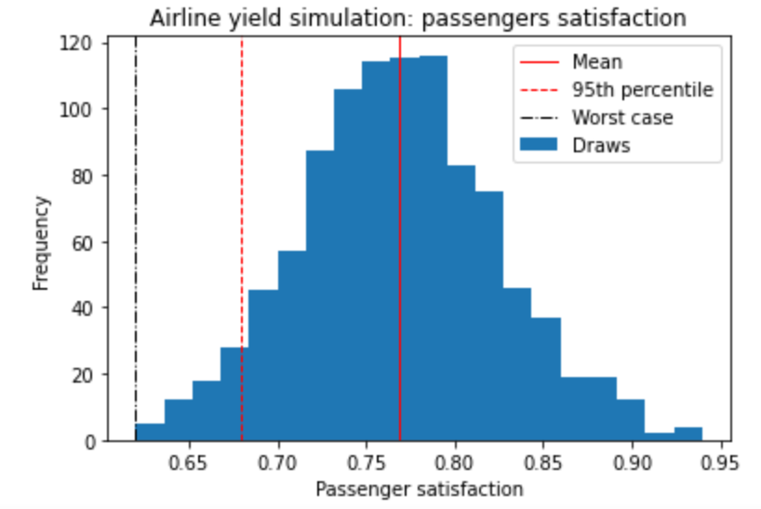
Statistics on highest-satisfaction solution
Mean: 128917.75
Bootstrapped MSE: 2493.3178449999727
Theoretical MSE: 2420.0474375
95% percentile: 125500.0
Bootstrapped MSE: 0.0
Mean: 0.7685496150235178
Bootstrapped MSE: 3.1259624022788576e-06
Theoretical MSE: 3.0759852254718447e-06
95% percentile: 0.6796462144308943
Bootstrapped MSE: 2.3177877785884735e-05

Slide 26
Conclusion
Simulation
A simulator was built for given passenger types with different arrival rates, fare buckets and inventory control methods.
Statiscal analysis: Revenue, seats sold, passenger satisfication and late passengers arrival.
Company mean revenue can be increased up to 6.76% (all seats sold, higher passenger satisfication), allowing all fares with a low bottstrapping MSE.

Slide 27
Conclusion
Optimization
Multi-objective optimization: revenue and satisfication (service).
FE, LS, VNS and SA used for maximum revenue and passenger satisification.
Influence of ticket availabilities, cut-offs and their combination on objective functions was studied.
VNS produces large pareto front as compared with other methods.
As revenue is increased, the passengers could not get their ideal choice seats.

Slide 28
Queries?
Thank you

